Slide 1
THE LIFE OF CHRIST
PART 32

Slide 2
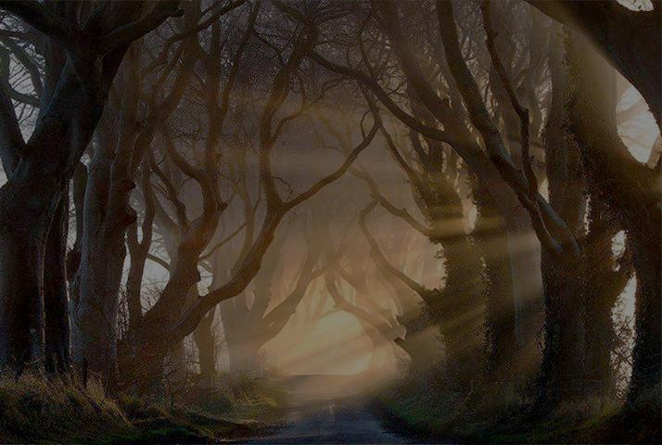
Matthew 7:13 " Enter by the narrow gate; for wide is the gate and broad is the way that leads to destruction, and there are many who go in by it. ¹⁴ "Because narrow is the gate and difficult is the way which leads to life, and there are few who find it.

Slide 3
Luke 13:23 Then one said to Him, "Lord, are there few who are saved?" And He said to them, ²⁴ "Strive to enter through the narrow gate, for many, I say to you, will seek to enter and will not be able.

Slide 4
strain every nerve to enter Lk 13:24 (BDAG).

Slide 5
Luke 14:25 Now great multitudes went with Him. And He turned and said to them, ²⁶ "If anyone comes to Me and does not hate his father and mother, wife and children, brothers and sisters, yes, and his own life also, he cannot be My disciple. ²⁷ "And whoever does not bear his cross and come after Me cannot be My disciple. ²⁸ "For which of you, intending to build a tower, does not sit down first and count the cost, whether he has enough to finish it -- ²⁹ "lest, after he has laid the foundation, and is not able to finish, all who see it begin to mock him,

Slide 6
³⁰ "saying, 'This man began to build and was not able to finish.' ³¹ "Or what king, going to make war against another king, does not sit down first and consider whether he is able with ten thousand to meet him who comes against him with twenty thousand? ³² "Or else, while the other is still a great way off, he sends a delegation and asks conditions of peace. ³³ "So likewise, whoever of you does not forsake all that he has cannot be My disciple.

Slide 7
1 Timothy 6:12 Fight the good fight of faith, lay hold on eternal life, to which you were also called and have confessed the good confession in the presence of many witnesses.

Slide 8
2 Timothy 2:11 This is a faithful saying: For if we died with Him, We shall also live with Him. ¹² If we endure, We shall also reign with Him. If we deny Him, He also will deny us.
James 5:10 My brethren, take the prophets, who spoke in the name of the Lord, as an example of suffering and patience. ¹¹ Indeed we count them blessed who endure.
Matthew 24:13 "But he who endures to the end shall be saved.

Slide 9
2 Timothy 4:6 For I am already being poured out as a drink offering, and the time of my departure is at hand. ⁷ I have fought the good fight, I have finished the race, I have kept the faith. ⁸ Finally, there is laid up for me the crown of righteousness, which the Lord, the righteous Judge, will give to me on that Day, and not to me only but also to all who have loved His appearing.

Slide 10
1) little, small, few 1a) of number: multitude, quantity, or size (Thayer).

Slide 11
1 Peter 3:20 who formerly were disobedient, when once the Divine longsuffering waited in the days of Noah, while the ark was being prepared, in which a few, that is, eight souls, were saved through water.

Slide 12
Numbers 14:29 'The carcasses of you who have complained against Me shall fall in this wilderness, all of you who were numbered, according to your entire number, from twenty years old and above. ³⁰ 'Except for Caleb the son of Jephunneh and Joshua the son of Nun, you shall by no means enter the land which I swore I would make you dwell in.

Slide 13
Proverbs 14:12 There is a way that seems right to a man, But its end is the way of death.

Slide 14
Matthew 7:15 " Beware of false prophets, who come to you in sheep's clothing, but inwardly they are ravenous wolves. ¹⁶ "You will know them by their fruits. Do men gather grapes from thornbushes or figs from thistles? ¹⁷ "Even so, every good tree bears good fruit, but a bad tree bears bad fruit. ¹⁸ "A good tree cannot bear bad fruit, nor can a bad tree bear good fruit. ¹⁹ "Every tree that does not bear good fruit is cut down and thrown into the fire. ²⁰ "Therefore by their fruits you will know them.

Slide 15
Luke 14:26 "If anyone comes to Me and does not hate his father and mother, wife and children, brothers and sisters, yes, and his own life also, he cannot be My disciple.

Slide 16
Matthew 10:37 "He who loves father or mother more than Me is not worthy of Me. And he who loves son or daughter more than Me is not worthy of Me.

Slide 17
Matthew 7:21 " Not everyone who says to Me, 'Lord, Lord,' shall enter the kingdom of heaven, but he who does the will of My Father in heaven. ²² "Many will say to Me in that day, 'Lord, Lord, have we not prophesied in Your name, cast out demons in Your name, and done many wonders in Your name?' ²³ "And then I will declare to them, 'I never knew you; depart from Me, you who practice lawlessness!'

Slide 18
Philippians 3:4 If anyone else thinks he may have confidence in the flesh, I more so: ⁵ circumcised the eighth day, of the stock of Israel, of the tribe of Benjamin, a Hebrew of the Hebrews; concerning the law, a Pharisee; ⁶ concerning zeal, persecuting the church; concerning the righteousness which is in the law, blameless.

Slide 19
Acts 22:6 "Now it happened, as I journeyed and came near Damascus at about noon, suddenly a great light from heaven shone around me. ⁷ "And I fell to the ground and heard a voice saying to me, 'Saul, Saul, why are you persecuting Me?' ⁸ "So I answered, 'Who are You, Lord?' And He said to me, 'I am Jesus of Nazareth, whom you are persecuting.' ⁹ "And those who were with me indeed saw the light and were afraid, but they did not hear the voice of Him who spoke to me. ¹⁰ "So I said, 'What shall I do, Lord?' And the Lord said to me, 'Arise and go into Damascus, and there you will be told all things which are appointed for you to do.' ¹¹ "And since I could not see for the glory of that light, being led by the hand of those who were with me, I came into Damascus.

Slide 20
Acts 22:16 And now why are you waiting? Arise and be baptized, and wash away your sins, calling on the name of the Lord.'

Slide 21
Matthew 7:24 " Therefore whoever hears these sayings of Mine, and does them, I will liken him to a wise man who built his house on the rock: ²⁵ "and the rain descended, the floods came, and the winds blew and beat on that house; and it did not fall, for it was founded on the rock. ²⁶ "But everyone who hears these sayings of Mine, and does not do them, will be like a foolish man who built his house on the sand: ²⁷ "and the rain descended, the floods came, and the winds blew and beat on that house; and it fell. And great was its fall."

Slide 22
Matthew 7:28 And so it was, when Jesus had ended these sayings, that the people were astonished at His teaching, ²⁹ for He taught them as one having authority, and not as the scribes.

